Slide 1


Business Process
A business process is a set of inter-related activities involving a number of actors and data triggered by a need and leading to an outcome
Examples
Order-to-Cash
Purchase-to-Pay
Application-to-Approval
Fault-to-Resolution
Hiring process

Slide 2
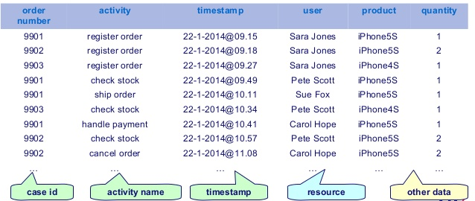
Event Logs
The data about the execution of business processes (aka event logs) are usually logged by the enterprises’ information systems
Analyzing process execution data allows organizations to extract information about the execution of business process.

Slide 3
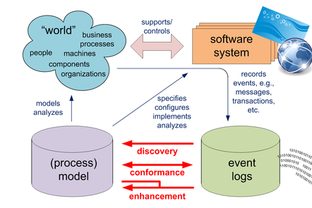
Process Mining
Process mining is a set of techniques that analyze event data to answer a variety of process-related questions.
Companies have incorporated such process mining techniques into their business processes

Slide 4
Predictive Process Monitoring
Predictive business process monitoring makes predictions/ estimations about the future states of an ongoing process execution.
It is a subfields of process mining and aims to provide timely information that enable proactive and corrective actions to improve process performance and mitigate risks.
Existing predictive techniques are used to predict:
The next activity to be executed in the process
The remaining time until the process is completed
The cost of completing the process
The possible rule violations
Etc.

Slide 5
Predictive Process Monitoring
Patient id | Age | Gender | Activity | Timestamp
patient_567339 | 33 | M | Provide the doctor with lab test Doctor diagnosis Surgery | 2009-01-01 11:55:25 2009-01-15 14:03:18 2009-01-28 16:56:53
Ongoing case 1
Patient id | Age | Gender | Activity | Timestamp
patient_456732 | 18 | F | Provide the doctor with lab test Doctor diagnosis | 2009-01-01 11:55:25 2009-01-15 14:03:18
Ongoing case 2
What is the next activity for patient_456732?
How long will it take to complete each running case?
Will there be any future delays?
Will there be any rule violations in the future?

Slide 6
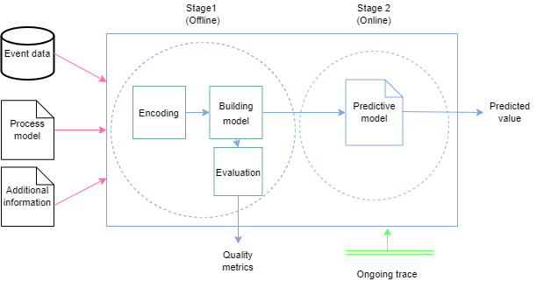
Predictive Process Monitoring
Expensive
Fast
Historical Data
Building predictor model
Prediction
Next activity
Remaining time
Cost
Etc.

Slide 7
Prediction
techniques
Type of prediction
Method used for building model
Remaining time
Outcome prediction
Next event
LTL rules
Risk prediction
Cost prediction
Process
awareness
Type of
problem
Predictor
Model
Produced
Model
Method
Process aware (PA)
Non Process aware (NPA)
Regression (REG)
Classification (CLAS)
Implicit
Explicit
One
Many
ML (DT, SVM,CLUS,Etc.)
ATS
STAT
Etc.

Slide 8



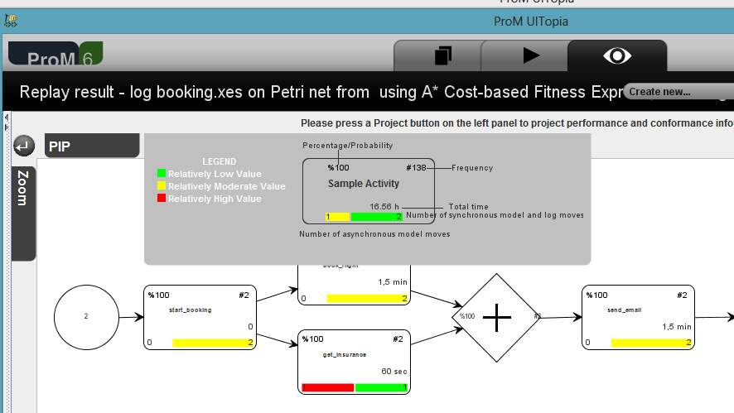
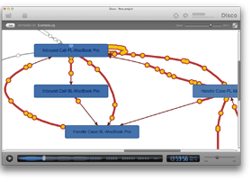
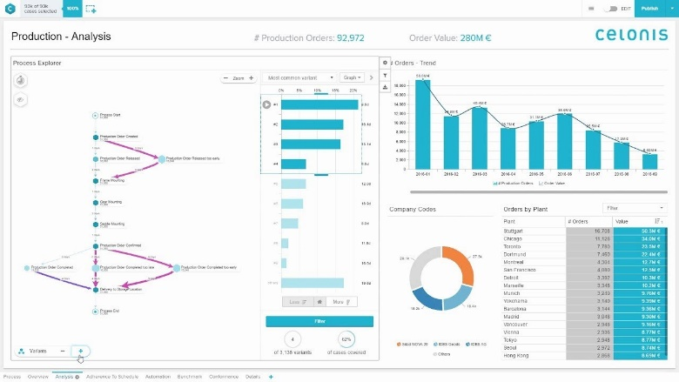

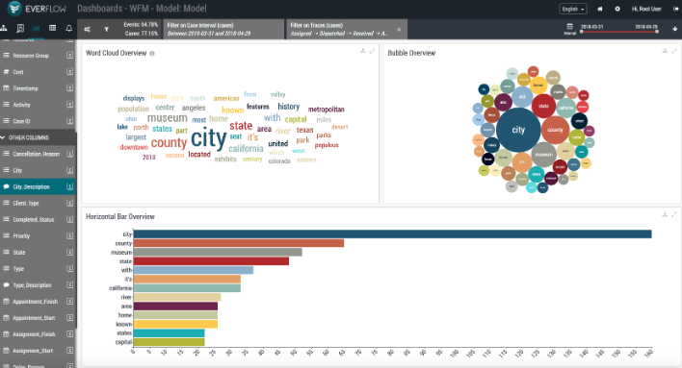
Process Mining Tools
…

Slide 9
Process Mining Tools
There is a large number of available tools and methods
The user should look for appropriate methods that meet their needs.
The user should be familiar with the available plug-in

Slide 10
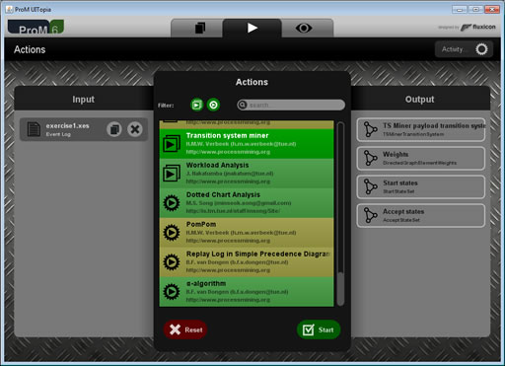
ProM Tool
ProM is an extensible framework that supports a wide variety of process mining techniques in the form of plug-ins
Search for the plug-in
Provide the inputs
Start the plug-in

Slide 11
ProM Tool
ProM plug-ins are distributed as separate packages
To use plug-ins in ProM their corresponding packages should be installed before using package manager.
Link to all ProM packages: https://svn.win.tue.nl/repos/prom/Packages/
Plug-in1
Plug-in 2
Plug-in 3
Plug-in 4
Plug-in 5
Plug-in 6
Prediction
package
PetriNet
package
Notes:
Most of packages could be installed using nightly builds version but not all.

Slide 12
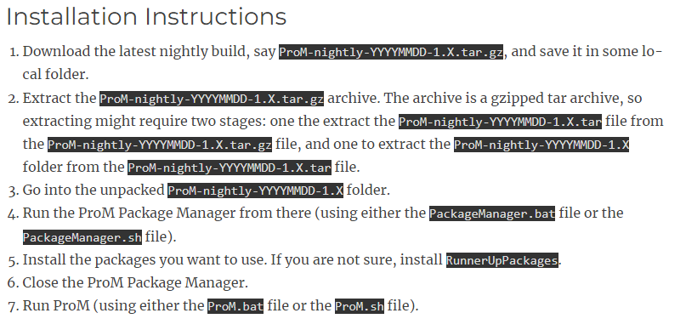
ProM 6 Nightly Builds
https://promtools.org/prom-6-nightly-builds/

Slide 13
Workshop- Part 1

Slide 14
Searching prediction plug-in using ProM interface
Search for ProM packages that may include prediction Plug-ins (https://svn.win.tue.nl/repos/prom/Packages/)
Install ProM Nightly Builds
Open the package manager, install RunnerUpPackages and the packages you discovered in step 1, then close the package manager.
Run ProM
Using the search tab, search for prediction plug-ins
Open the link and fill the google form https://forms.gle/S7TESmYwfGnvy4pA7

Slide 15
Workshop- Part 2

Slide 16
Searching prediction plugins from literature reviews
Navigate to the link https://docs.google.com/spreadsheets/d/1l1enKhKWx_3KqtnUgggrPl1aoJMhvmy9TF9jAM3snas/edit#gid=959800 and the predictiveMethods.pdf file. These documents are extracted from the most recent systematic reviews on process prediction. They demonstrate a comparison of different predictive methods. A Tools column in the spreadsheet indicates whether the proposed method is available online and the name of the tool where it is implemented.
A set of use cases for searching for a specific prediction method are presented in the next slide. Using the tables in the spreadsheets or/and in the predictiveMethods.pdf file, search for at least one suitable method for each use case and that has been implemented in ProM.
If you found a suitable method in the spreadsheet, get the article name from the Document Title column where the method was described.
If you found a suitable method in the predictiveMethods.pdf file, take note of the corresponding reference number, then go to the reference and look up the article title.
Copy and paste the method's corresponding article title into your internet navigator after you've found it. You can now access the article's pdf file. Search for the name of the implemented package in ProM (if it exists) as well as the names of the corresponding plugins (if they exist).
Make a note of whether you found the method, the package name, and the plugin names for each use case.
Open the link and fill the google form https://forms.gle/uFJ8mBs2uBxddVCV9

Slide 17
Searching prediction plugins from literature reviews
Use case1: predict the next activity in an ongoing case.
Use case2: predict LTL rules violation.
Use case3: use machine learning classification model to predict next activity
Use case4: predict the process remaining time using svm algorithm
Use case5: generate a stochastic petri net to predict the remaining time
Use case6: build a decision tree as predictor model to predict data attribute
Use case7: build decision tree for risk prediction
Use case8: predict remaining time using transition system

Slide 18
Workshop- Part 3

Slide 19
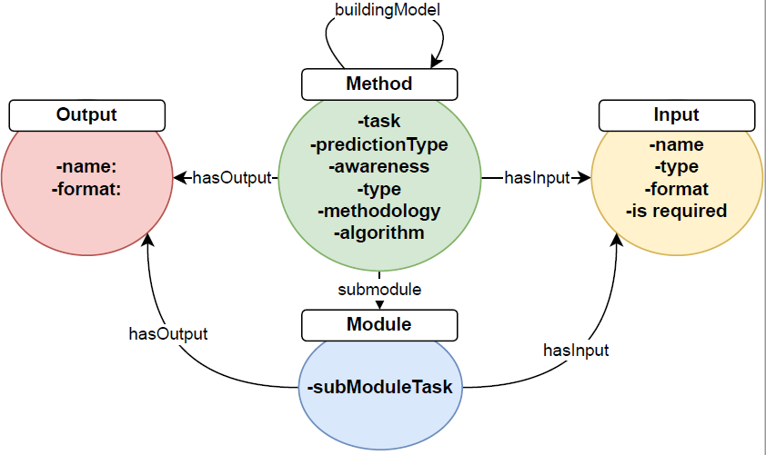
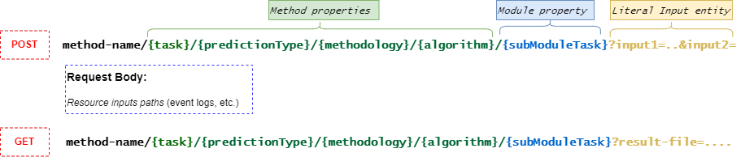
Rest API design for predictive methods

Slide 20
Rest API design for predictive methods
Examples:
build_model/ next_activity/ machine_learning/ decision_tree
build_model/ rem_time/ annotated_transition_system/ stochastic_petriNet
predict/ rem_time/ annotated_transition_system/ stochastic_petriNet
For each of the preceding use cases, search for the method’s API from the list of the provided Rest APIs
Open the link and fill the google form https://forms.gle/rxHm6g5QU1Ar3BLQ8

Slide 21
Searching prediction plugins from literature reviews
Use case1: predict the next activity in an ongoing case.
Use case2: predict LTL rules violation.
Use case3: use machine learning classification model to predict next activity
Use case4: predict the process remaining time using svm algorithm
Use case5: generate a stochastic petri net to predict the remaining time
Use case6: build a decision tree as predictor model to predict data attribute
Use case7: build decision tree for risk prediction
Use case8: predict remaining time using transition system

Slide 22
Searching prediction plugins using Rest API schema
Rest API1: build_model/ next_activity/ machine_learning/ decision_Tree
Rest API2: build_model/risk/machine_learning/ decision_Tree
Rest API3: predict/rem_time/annotated_transition_system
Rest API4: build_model/ rem_time/ annotated_transition_system/ stochastic_petriNet
Rest API0: predict/ rem_time/ annotated_transition_system/ stochastic_petriNet
Rest API5: predict/outcome/clustering/transition_system
Rest API6: predict/LTL/ machine_learning/ decision_Tree
Rest API7: build_model/LTL/decision_tree
Rest API8: predict/rem_time/machine_learning/SVM
Rest API9: build_model/next_activity/annotated_transition_system/machine_learning/NB
Rest API10: build_model/rem_time/annotated_transition_system/machine_learning /SVM
Rest API11: predict/next_activity/annotated_transition_system/machine_learning /NB
Rest API12: predict/rem_time/ annotated_transition_system/machine_learning /SVM
Rest API13: predict/ next_activity/machine_learning/neural_network
Rest API14: build_model/data/machine_learning/decision_tree
Rest API15: predict/data/machine_learning/decision_tree

